Slide 1
Coding Contest Prep

Slide 2
Announcements
Entry opens on 18th
I will take care of teams entries. Think I might need your “id or username or something”
I need your github id so I can invite you to Prof-Greg/contest. Right now is public but I want to switch to private.

Slide 3
Agenda
Coding Contest Format, Rules, Judging, ->Update
Review what we learned last time
Haydon go over subsequence bit manipulation
Critical STL structures we haven’t covered in class yet
Problems – super easy -> medium

Slide 4
What I know now
5 hours
Single computer – theirs
No notes, thumb drives, ect.
No internet
I have last contests problems, but no answers
They will use a combination of on line judge and manual judging
Problems will be easier than last contest.
Works to our advantage

Slide 5
What I know now
Update:
We will be able to bring in 2 sheets of paper – I am assuming each – with whatever you want on them. Suggest team strategy

Slide 6
Being Good at Contests and coding in general
Learn how to type – faster the better
Be able to quickly identify problem types
Do algorithm analysis based on problem parameters
Master a programming language – For us its c++ now. This can evolve.
Master code testing – identifying test cases

Slide 7
Problem Types
Ad Hoc
Complete Search
Divide and Conquer
Greedy
Dynamic Programming
Graph
Mathematics, discrete math
String Processing
Computational Geometry
Hard/Rare problems

Slide 8
Algorithm Analysis
Try to understand how good your algorithm needs to be.
Think about input set size
Look at time to compute versus any time limits

Slide 9
Master Language
That’s what we are trying to do
Use STL
Use C++ 11
Use C
Fundamentals
I/O is super important

Slide 10
Master Test Cases
Edges
Don’t just assume limits are anywhere like examples
If it doesn’t say it can’t be it can be!!!!
WE WILL PRACTICE THIS TODAY

Slide 11
Review
I/O
cin seemed to work best for the most
I created a living document on Prof-Greg/contest for us to document best ways to I/O various things in. Lets update that! As we go along I will try to come up with a way to capture best practices so we can remember what works best
Assumes you all might want to do more contests

Slide 12
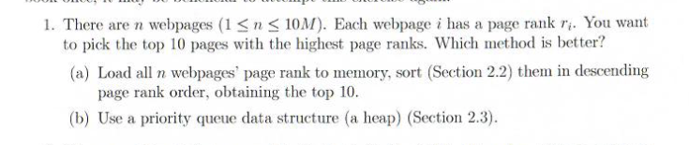
Lets get started

Slide 13
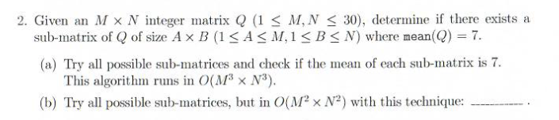
Lets get started

Slide 14
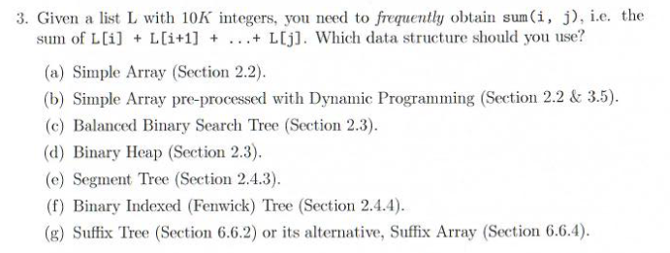
Lets get started

Slide 15
MAPS
Balanced Binary Tree is under a STL MAP
Can be given a Compare Functor return bool
Maps are associative containers that store elements formed by a combination of a key value and a mapped value, following a specific order.
In a map, the key values are generally used to sort and uniquely identify the elements, while the mapped values store the content associated to this key. The types of key and mapped value may differ, and are grouped together in member type value_type, which is a pair type combining both:
typedef pair<const Key, T> value_type;
Internally, the elements in a map are always sorted by its key following a specific strict weak ordering criterion indicated by its internal comparison object (of type Compare).
map containers are generally slower than unordered_map containers to access individual elements by their key, but they allow the direct iteration on subsets based on their order.

Slide 16
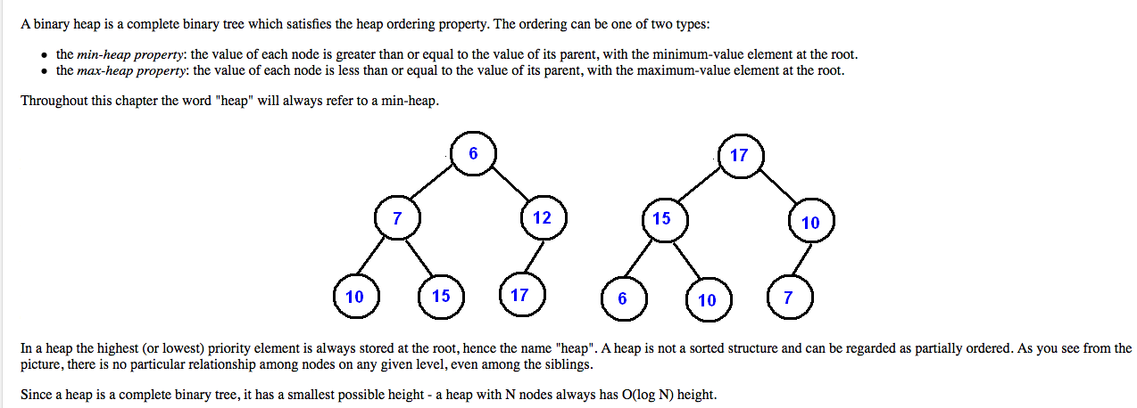
Binary Heap

Slide 17
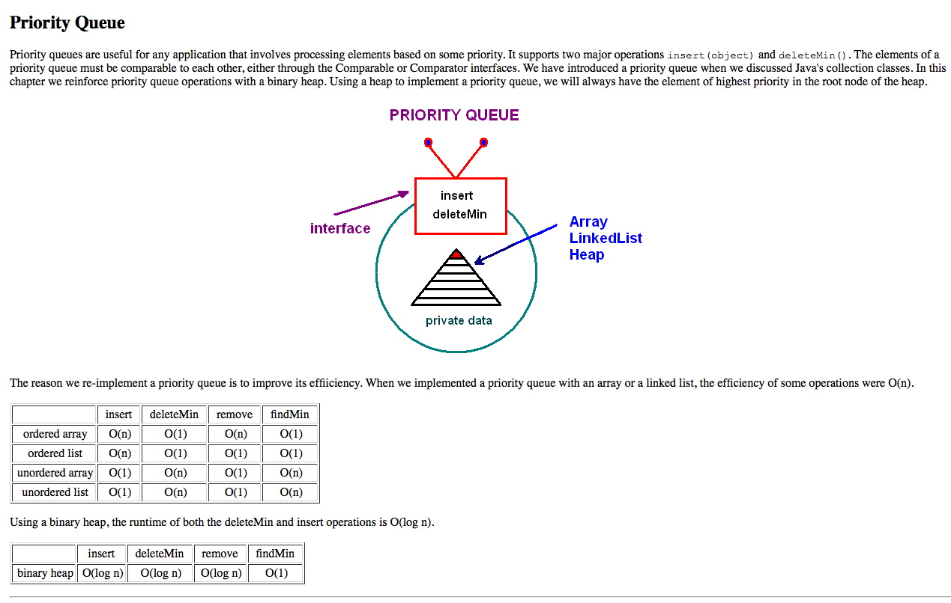
Priority Queue

Slide 18
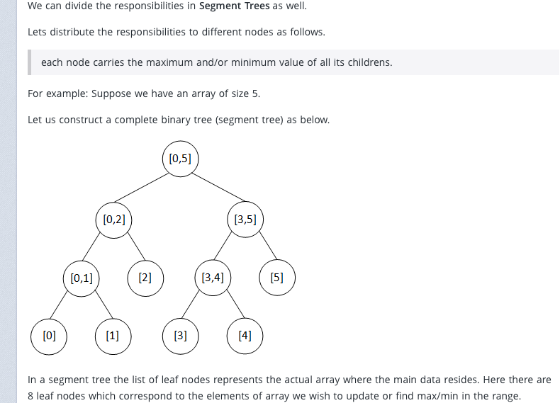
Segment Tree

Slide 19
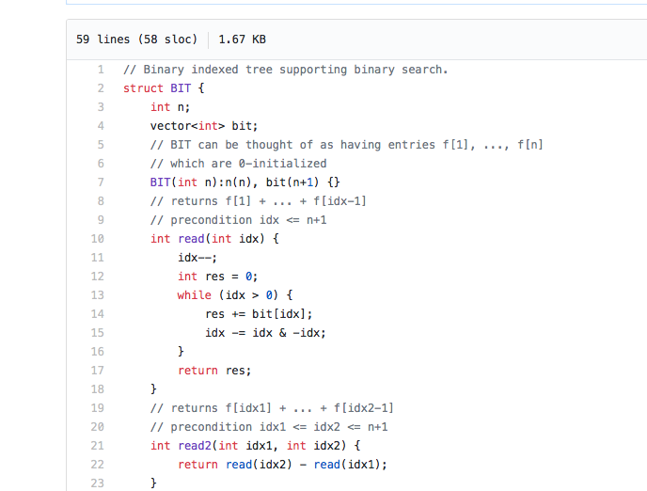
Binary Index Tree
https://github.com/t3nsor/codebook

Slide 20
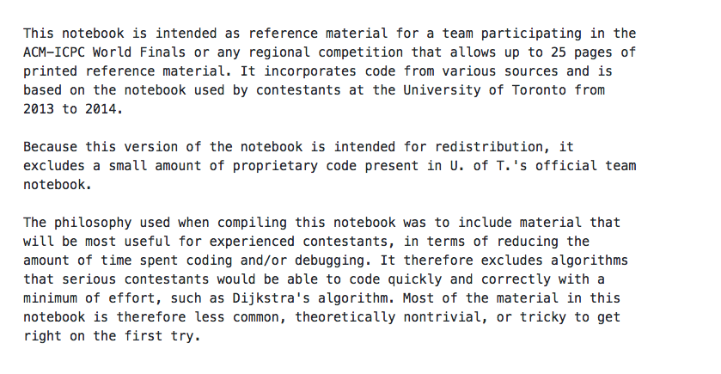

Slide 21
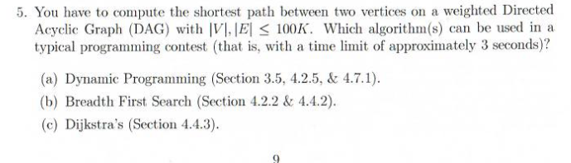
Lets get started

Slide 22
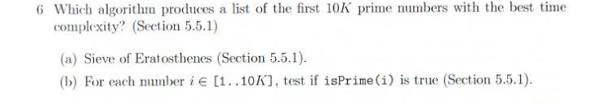
Lets get started

Slide 23
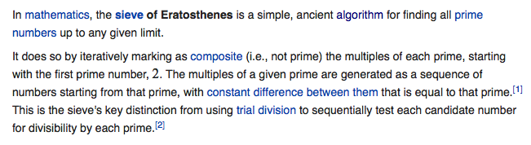
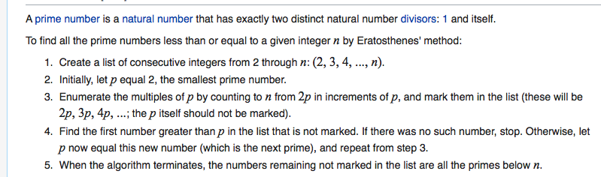
Sieve of Eratosthenes

Slide 24
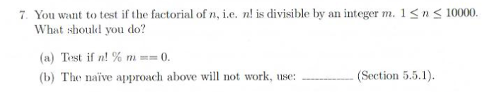
Lets get started

Slide 25
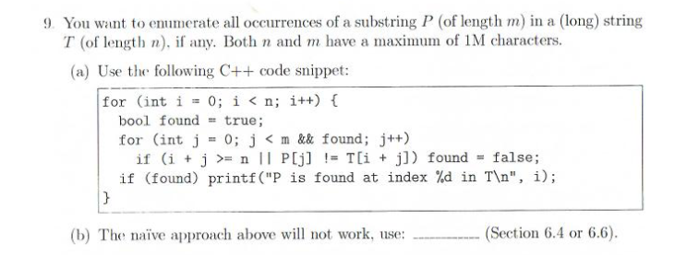
Lets get started
Suffix Tree!

Slide 26
Summary
You know a lot

Slide 27
Summary
You know a lot
Lots to know!

Slide 28
Fire Up Uva Judge
Six easy problems –
Lets practice hammering in the #defines and the i/o
I will give you the uva number
get it up read it as a team and figure out the attack, limitations, any algorithmic issues.

Slide 29
11772

Slide 30
11498

Slide 31
11727

Slide 32
10114

Slide 33
11799

Slide 34
12015

Slide 35
Using a Judge
Register at https://uva.onlinejudge.org
Browse problems
example:
Root :: Competitive Programming 3: The New Lower Bound of Programming Contests (Steven & Felix Halim) :: Data Structures and Libraries :: Linear Data Structures with Built-in Libraries :: C++ STL algorithm (Java Collections)::Birthdates

